Slide 1
Exceptions in degree Works
Notes:
Change Log as of 25Mar2020:​
-Added new Unique Situation​
-Handling MATH 1513/1613/1813/1715​
Change Log as of 06Oct2021:​
-Replaced screenshots ​
Change Log as of 16Feb2022:​
- Added DWTerm to WITH section​
​
Change Log as of 14Apr2022:​
-Added DW Grade Number to WITH section

Slide 2
Exception Types
Force Complete
Substitute
Also Allow
Apply Here
Remove Course/Change the Limit
Notes:
There are five distinct types of exceptions in Degree Works, and a user with access to add exceptions can use any of them

Slide 3
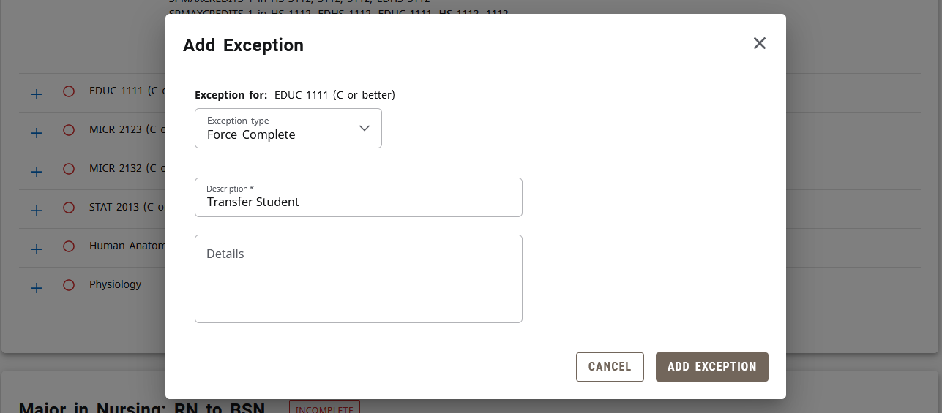
Force Complete
Completes a rule w/o applying classes or credits
  Independent of student data
Very powerful – should only be used as a last resort
Notes:
Force Complete will complete (meaning green check box, no further work needed) the selected rule without applying additional classes. It can be used to complete individual course rules, groups of rules in a subset, and/or qualifiers like minimum grades.
This exception does not look at any student data, and therefore is not limited by it. You can do a lot with this powerful exception!

Slide 4
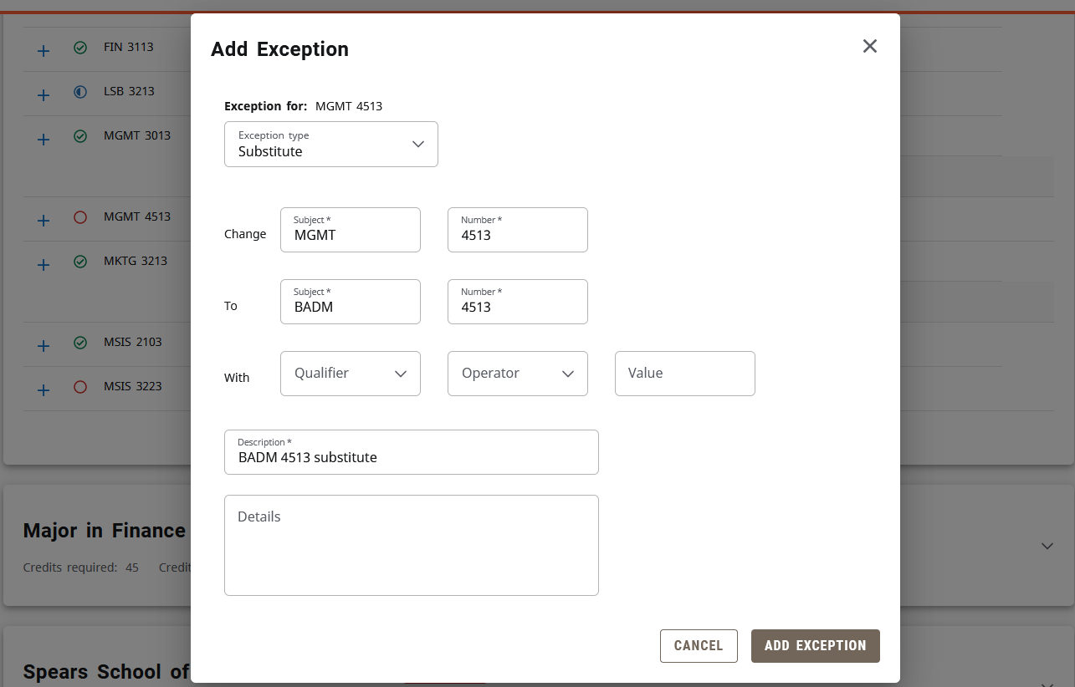
Substitute
Substitutes one course for another
Notes:
Similar to our current culture of substitutions. One course is required, another is substituted for that rule. However, if there are other qualifiers within the block that the new course doesn’t satisfy, then the course won’t show.
For example, the block has a “MaxClasses Zero in CHEM @” rule (no chemistry courses allowed in this block), and you try to substitute a CHEM class for a BIOC requirement.
Also Allow is recommended over Substitute, since it is much more flexible in relation to student coursework

Slide 5
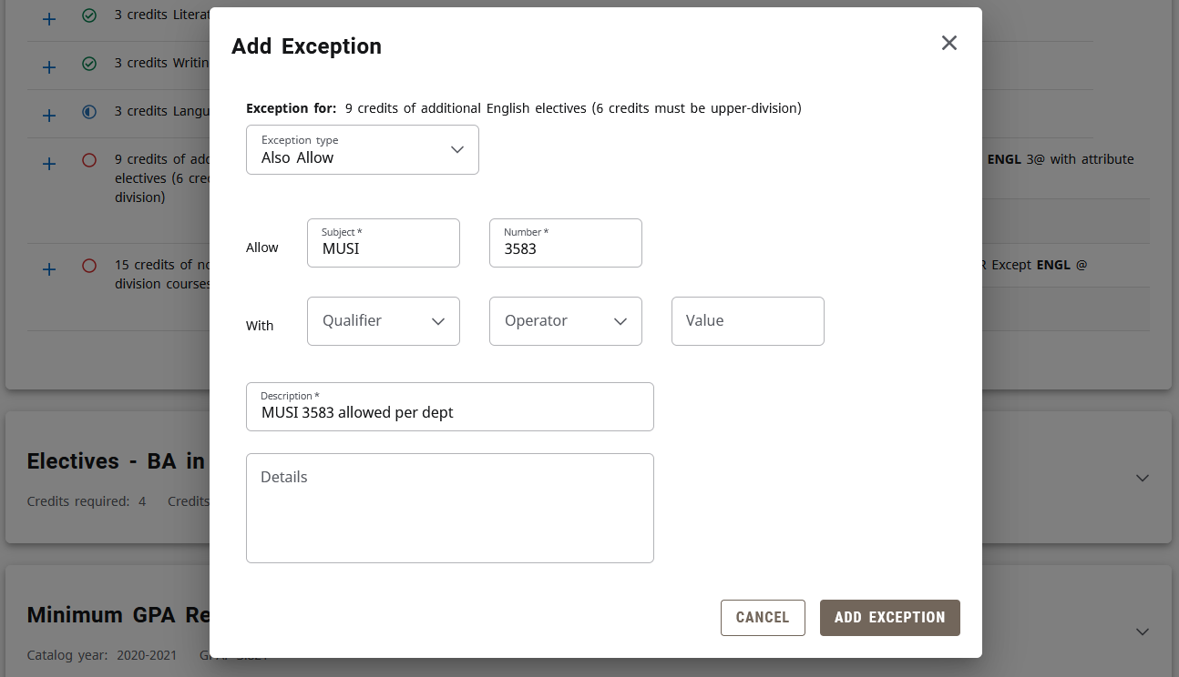
Also Allow
Adds a new course option
Can be done prior to completion of coursework
Most flexible exception
Notes:
The Also Allow exception modifies a rule by adding an additional course to the list of courses that can satisfy the requirement.
Think of it like an additional “or” statement
Like Substitute, this exception is subject to rule qualifiers like Minimum Grades and can be refined using the “With” section.
This exception can be done prior to completion of coursework. As you can see in the example, the requirement is for ENGL courses, but they’re also allowing MUSI 3583 to place into the rule. The exception will be saved to the database whether or not the student has MUSI 3583 on their record.
Different from Substitution, which will only go through if you identify a class from the student’s record
The Wildcard (@) can also be used here. So you could say
MUSI 3@ = any 3000-level Music class
@ 4990 = any special problems class
@ 4@ = any 4000-level class, any subject
Also Allow is one of the best to use because it’s so flexible. You can add exceptions and the auditor will fill in classes on its own as the student takes them.

Slide 6
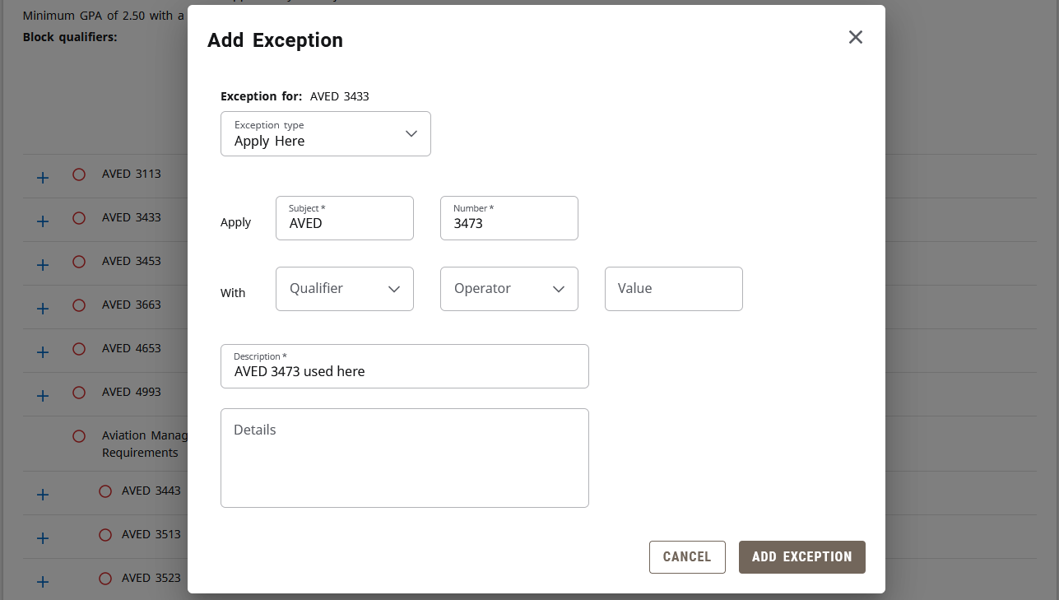
Apply Here
Applies a specific course to a rule
Overrides the auditor’s logic
Notes:
This kind of exception allows a user to apply a course to a rule, regardless of rule qualifiers like minimum grades.

Slide 7
Apply Here
WARNING!
  Apply Here on an in-progress course will cause it to remain in the audit even if they receive an “F”
  Excessive sharing can occur as a result of forcing courses into the audit
Notes:
If used with an in-progress class, the rule will be satisfied even if they don’t pass!
See next section for safeguards
Excessive sharing can also occur using this exception.
Because of this, it’s always safer to use Substitute/Also Allow instead.

Slide 8
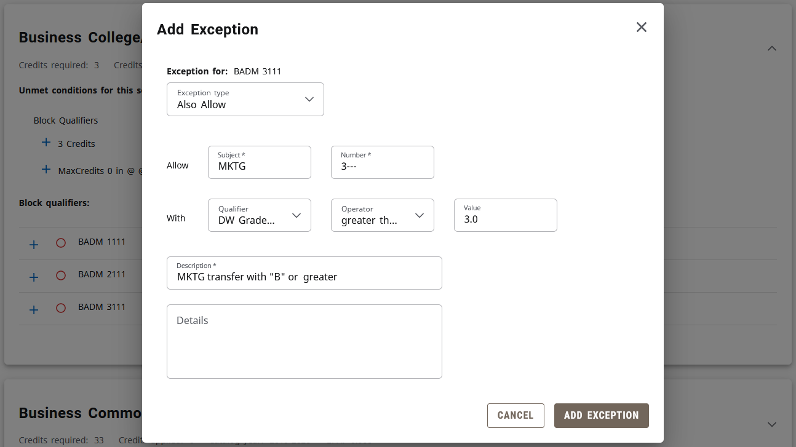
“With”
Optional
Drop-downs allow for better selection
Applies to Substitute, Also Allow, & Apply Here
Notes:
Usually, this feature will only be necessary for multiple instances of transfer work (e.g. BIOL 1--- & BIOL 1---). Courses taken in residence will rarely need this feature.
Using the drop-down menus on the With section allows the class being used for the exception to be more finely selected by the user. In this example, the auditor will only look for instances of MKTG 3--- that have a grade of “B” or better. This is helpful if the student took it more than once.
This section is usable for Substitutions, Also Allows, and Apply Heres.

Slide 9
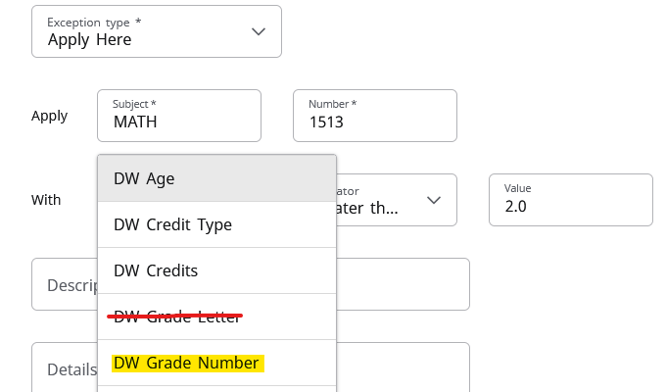
“With”
If an Apply Here must be used on an in-progress course, use “With” to ensure a passing grade
Notes:
Specifying a grade is recommended when using Apply Here on an in-progress course. Otherwise, if the course is failed the Apply Here will force the "F" into the audit
Use “DW Grade Number” qualifier, the “greater than or equal to” operator, and one of the following values:
1.0 = D
2.0 = C
3.0 = B

Slide 10


“With”
DW Transfer Course/DW Title
Notes:
If a student has multiple transfer courses that have articulated as the same course (commonly with dashes ----/2---), you can use the “with” section to make sure you grab the right one for the rule.
“DW Transfer Course” or “DW Title” will be the best to use in most cases.

Slide 11
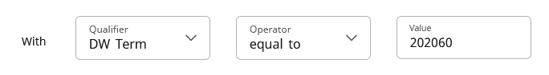
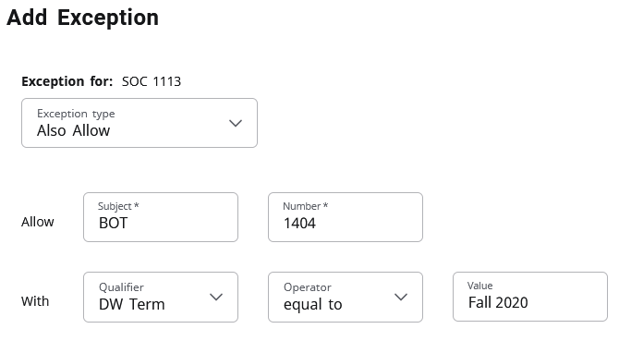
"With"
DWTerm
✓
Notes:
As of 5.0.5, when specifying a term the six-digit code must be used

Slide 12
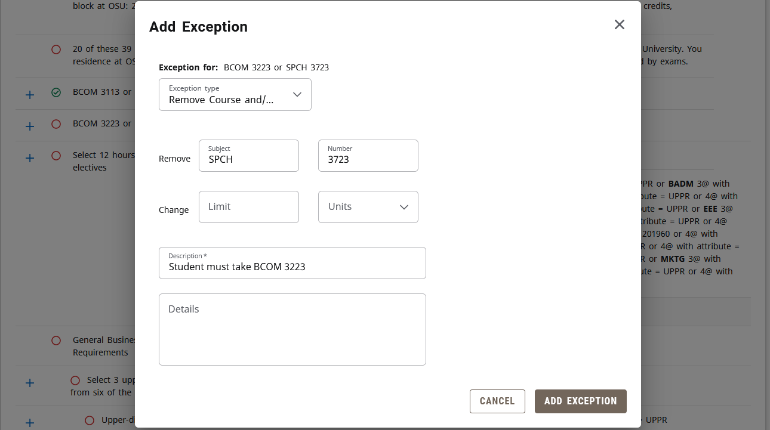
Remove Course/Change the Limit
Removes a course from a list
Notes:
The Remove Course exception removes a course from a list of options that could satisfy the rule. In the example here, they are no longer allowing SPCH 3723 to satisfy the “BCOM 3223 or SPCH 3723” requirement. A student would have to earn 3 credits in BCOM 3223 only.
It can also be used to prevent a certain course from satisfying a requirement through a wildcard
For example, if a rule was 9 Credits in HIST @, you could “remove” HIST 1103 so that other history courses could apply to the rule, but 1103 would not

Slide 13
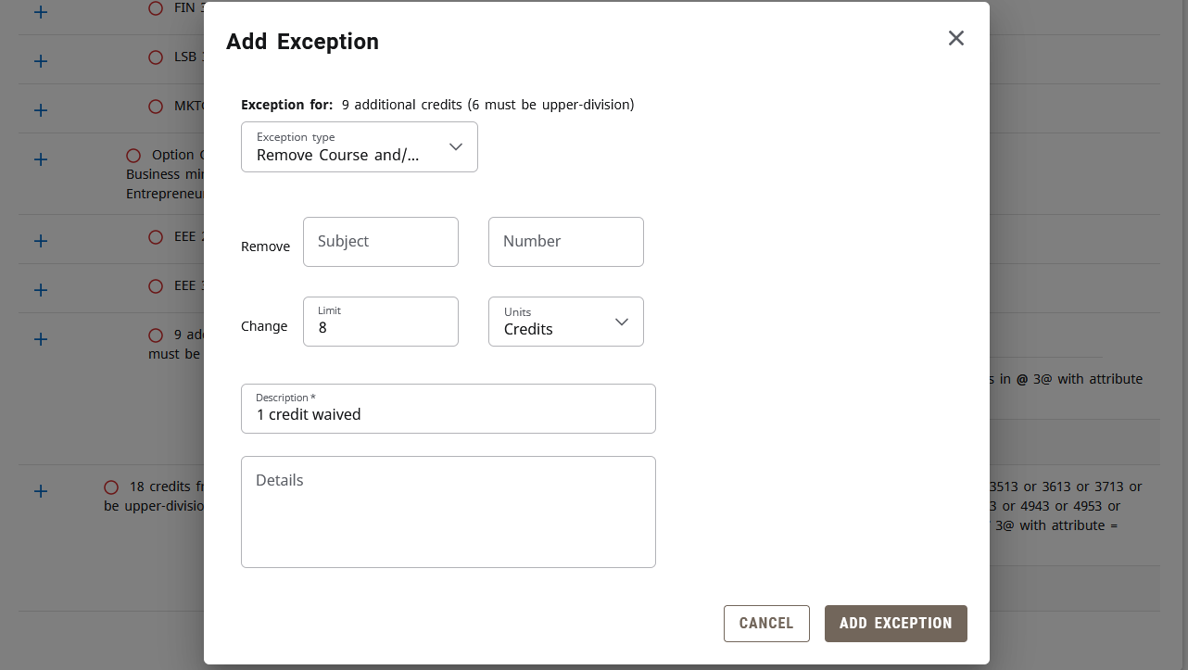
Remove Course/Change the Limit
Increase/decrease needed credits/classes
Change credits to classes or vice versa
Notes:
It is used through the drop-down menu just below the Subject and Number fields
Users would add this exception if they wanted to change a requirement from Credits to Classes (or vice versa), or if they wanted to reduce or increase the number of credits or classes required for the rule
The two exceptions would sometimes be used in tandem – removing a course and reducing the credit requirement by the credits of the removed course

Slide 14
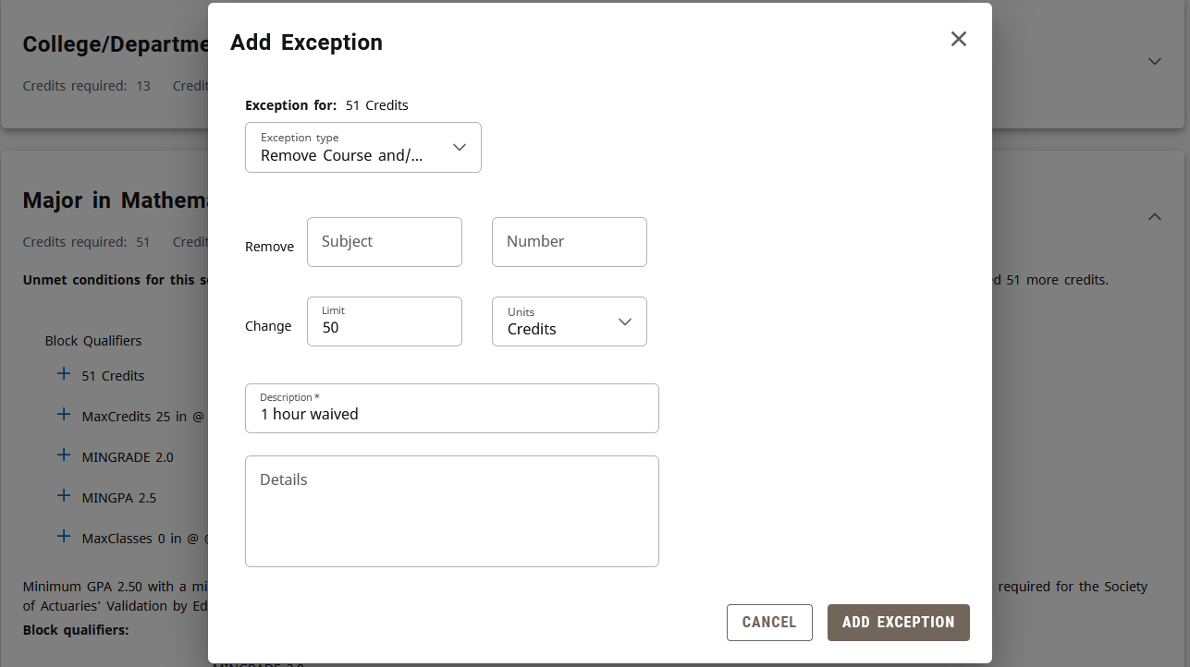
Remove Course/Change the Limit
Reduce credits for requirement, then reduce credits for entire block
Notes:
If the requirement that you’re adjusting is in a block that has an overall credit count (like the example above), you will need to change the overall limit here too.
This way, once the student has completed the other requirements, the overall credit will also be satisfied.

Slide 15
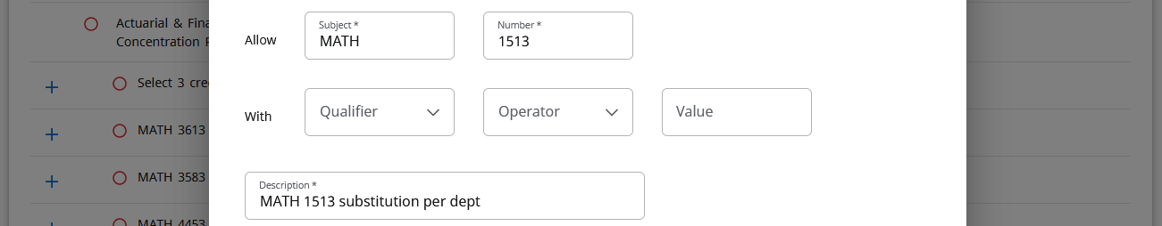
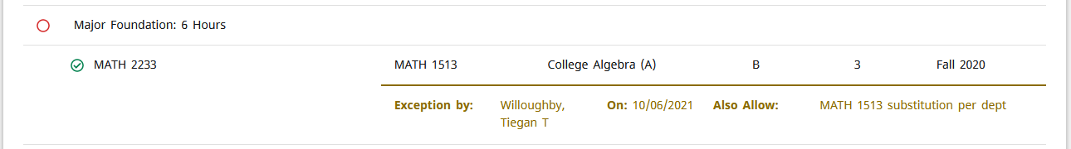
Descriptions
Visible to everyone, including students!
Be consistent and include the course
Don’t type (included by default)
  Name, Date, Exception Type
Notes:
The auditor requires a description for every exception. If you don’t provide one, the auditor will generate a basic description that includes the class used and the exception type.
Remember, what you type here is visible to all users – other faculty and staff, as well as the student!
There is currently no standard wording for exceptions, but there are a few things to remember for best practices
Try to use consistent wording and/or abbreviations for the exceptions within your college. There is a reporting function within exceptions, and consistent wording can help us identify “like” exceptions. It also makes things more clear for the certifications team within the Registrar’s Office to understand the exception.
Each exception should also include the course that you’re using. This makes it much easier to see which exception goes with which course when there is more than one on a student’s record. It really helps with troubleshooting as well so that you don’t end up deleting the wrong exception.
Don’t bother typing your name/initials, the date, or the type of exception. Those will be included by default in other areas of the exception

Slide 16
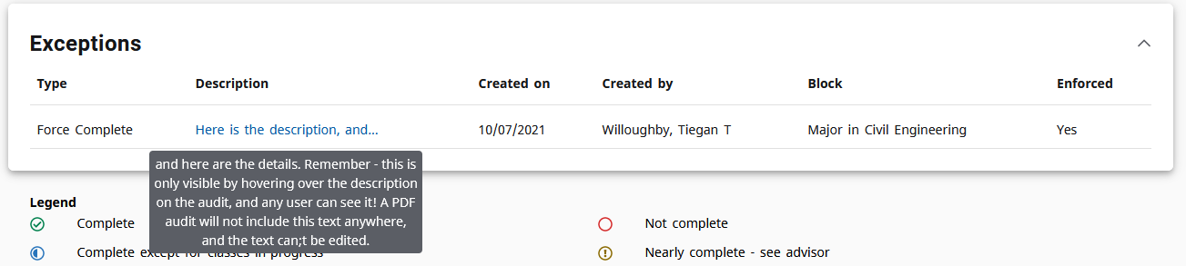
Details
Need more space? Details button provides 220 characters
Only visible by hovering over Description in the Exceptions block
Won’t be included on PDF
Notes:
Just like the description, the details section is visible to every Degree Works user. There are no internal notes.
The Details field will be below the Description field
This box will let you type more than 220 characters and save with no issue, but will remove everything beyond 220 characters

Slide 17
Unique Situations
2-for-1 exceptions
Fractional transfer work (2.68)
Repeated course, received “F”
“Plus-list”
Long title
Remove equivalent course
Force Complete Range Requirement
MATH 1513/1613/1813/1715
Notes:
Sometimes it won’t be immediately clear which exception you should use. Rather than give up and use Force Complete, look on the following slides for some unique examples
When all else fails, e-mail degreeworks@okstate.edu!

Slide 18
2-for-1 Exceptions
If you can fit both courses in the requirement, just do two Also Allow exceptions
  Requirement: 4 Credits in BIOL 1114
  Exception: BIOL 1--- (3 credits) and BIOL 1--- (1 credit)
If you can’t fit both courses in the requirement, first Change the Limit to make room for the second course. Then, do your two Also Allow exceptions
  Requirement: 3 Credits in ECON 2103
  Exception: AGEC 2313 and AGEC 2303

Slide 19
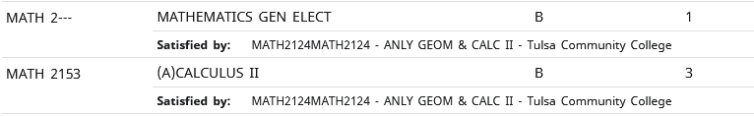
2-for-1 Exceptions
If a student took a course for more credits than it is offered for at OSU, then it may be split into two courses like this example:
Be sure to note the original course titles displayed below each course. This will help you “link” them in Degree Works

Slide 20
Fractional Transfer Work
Students from trimester schools – 2.68 credits
The course is probably already applying to the rule
  Change the Limit of the requirement to 2.68 credits
  Change the Limit of the overall credit count for the block (if waiving, don’t change it if the student still needs the credit)
Due to rounding, it may be necessary to instead change the limit to “2” or just “2.6” instead of exactly the decimal displayed.

Slide 21
Repeated Course, Received “F”
Sometimes a student that makes a “D” will repeat the same course and receive a grade of “F” the second time
The first grade is now insufficient (marked as a repeated course), and the “F” is also insufficient (failing grade)
Contact the Academic Records team in the Office of the Registrar to request manual adjustment of the repeat process, rather than using Exceptions

Slide 22
“Plus-list”
If you’re coming across a requirement that just seems to ignore the Also Allow’s and Apply Here’s you throw at it, it’s probably a “plus-list”
  A “plus-list” uses the AND operator instead of OR
In these situations, you must use the Substitute exception type

Slide 23
Long Title
When identifying a course using the “With” function, the text box only has room for 30 characters
This isn’t a problem when using DW Term or DW Credits, but DW Title can be longer than 30 characters
Paste as much of the title that will fit, and then replace the 30th character with an “@”
Notes:
Introduction to Biological An@

Slide 24
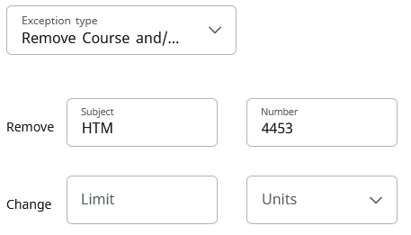
Remove equivalent course
When removing a course from a rule, the exception won’t work if that course has a new equivalent
  E.g. Student took HRAD 4453 in Fall 2012. This course recently became HTM 4453 and the two are therefore equivalent.
You’ll have to reference the new course when processing your exception

Slide 25
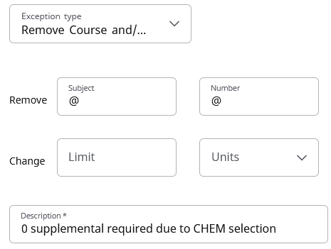
Force Complete Range Requirement
When a requirement is Scribed as a range (e.g. 0:3 credits), Force Complete will not prevent coursework from applying to the rule.
Instead, do a Remove Course exception and put wildcards in both of the fields

Slide 26
MATH 1513/1613/1813/1715
These MATH courses have a unique statement in their descriptions that requires complex enforcement in Degree Works
  “Combined credit toward a degree…limited to six hours.”
If adjustments are needed beyond what exceptions can handle, contact degreeworks@okstate.edu. There is a special way that these courses can be handled on a student-by-student basis.

